Slide 1
Diversity Forum New Manifesto
Tuesday 25th January 2022

Slide 2
About the Diversity Forum
Who?
Steering Group: 6 members meet bi-monthly
Champions Network: 30+members meet quarterly (Share learning, training etc)
Why?
Our aim is for a more representative, diverse and inclusive social investment sector
How?
Monthly newsletters, online monthly talk events, YouTube channel, Manifesto & Programmes of Action (tbc)

Slide 3
Why do we need another Manifesto?
8 sign ups
No specific or measurable actions
No definitions
Inspired by the HM Treasury Women in Finance Charter– need something specific to the sector
Feedback from sector leaders:
Not sure where to start with EDI journey
Fear of getting it wrong
Original Manifesto
We will commit to diversity in our team at a staff and governance level.
We will commit to exploring approaches and methods that help to bring equality, diversity and inclusion in how investment decisions are made in the social investment space across the UK.
We will commit to exploring new mechanisms to support organisations to become more diverse across the UK.
We will commit to finding ways to encourage social investments to support the full range of diverse recipients and issues we have in the UK.

Slide 4
What we’ve done so far…
Shared initial ideas with the Diversity Forum Champions Network
Held a 90 minute discussion with Diversity & Inclusion leaders within the sector including Voice4Change, EIIP and the SIF
Reached out to a member of the SIB community panel for feedback and comments
Intensive engagement from Diversity Forum Steering Group members

Slide 5
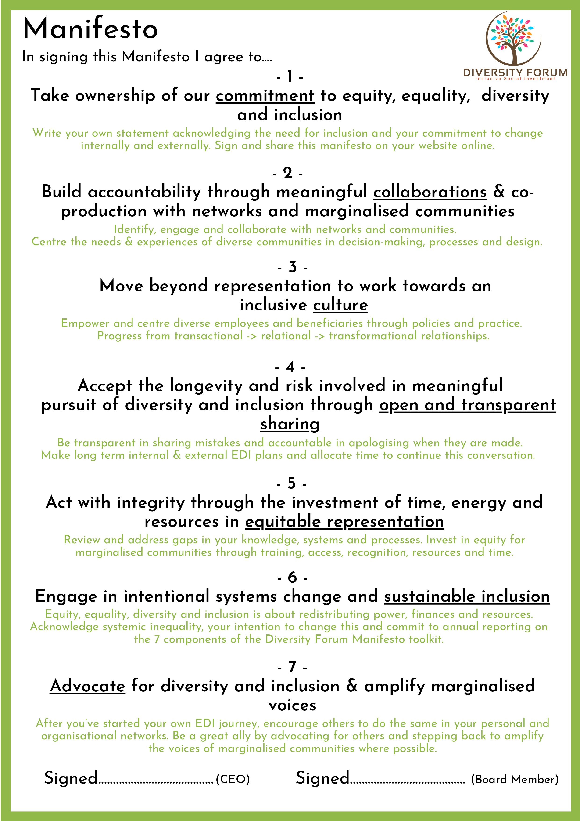
Our 7 pledges & criteria
Commitment
Collaboration
Culture
Open & Transparent Sharing
Equitable Representation
Sustainable Inclusion
Advocacy

Slide 6
10 Initial Actions for the First 6 months
A deliberate mix of short & long-term actions to get started
Logistical ease vs unknown challenges and barriers
An opportunity to collaborate and share ideas with other signatories
An opportunity to ask for support from the Diversity Forum, peers and consultants/experts
Overcome fear/fear culture by working openly to set goals

Slide 7
How it works
Read & Sign the Manifesto
Start on our 10 initial actions
Continue to develop & grow
CEO & Board level signature
Nominate DEI stakeholder
Share logos on our website and yours!
Reach out for support
Tick off those you’ve done already
Set realistic goals and begin working on actions
Attend summer event to share progress and best practice
Report on our 7 criteria each year
Continue working towards 10 initial actions
Build relationships and networks for sustainable growth

Slide 8
How will the Diversity Forum support us?
Reach out to us to work together on your 6 month and 1 year goals!
Set tailored goals that are achievable for you
Collaborate with other signatories on shared challenges
Anonymous Q&A at Champions Network meetings
Peer support for emotional wellbeing of EDI leads
3 month check-in
6 month Summer Summit
Flexible annual reporting: videos, reports, case studies etc
Training, resources and consultants
Work with others to address challenges & barriers and set standards - from competition to collaboration.

Slide 9
What next?
Our Manifesto will be officially published on Monday 31st January 2022
Sign our Manifesto (CEO & Board member) and return to us so we can add your logo to our website and vice versa
Arrange an initial 1:1 with your nominated D&I lead to work on your goals/targets
If you haven’t already, sign up to the Diversity Forum mailing list and Champions Network
We will check in with you after 3 months and invite you along to our summer event to share learnings and best practice with others
Provide your annual report next January and work with us to improve diversity and inclusion in our sector

